Slide 1
Investigation of High-Capacity Digital Coherent Transceivers
Aimilios Christou, G&C College, ac2146

Slide 2
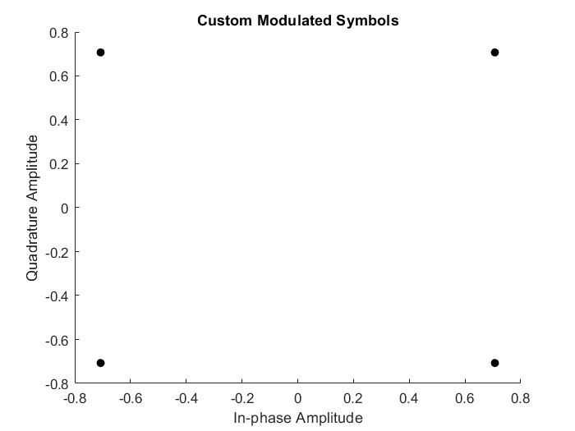
Modeling the transmitter
Began by sending a collection of 10000 random symbols
Modulation with gray-mapped QPSK (Matlab function)
Adding random noise in amplitude and phase
Implementation of my own QPSK function to better understand the concept
Demodulation with Matlab-provided functions
Week 1

Slide 3
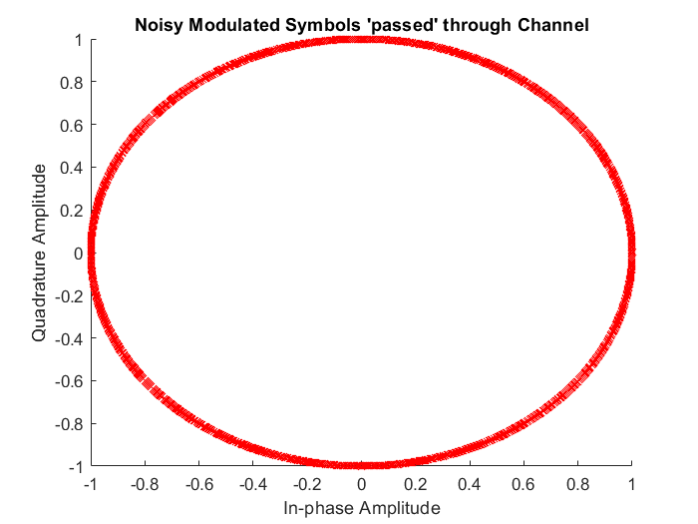
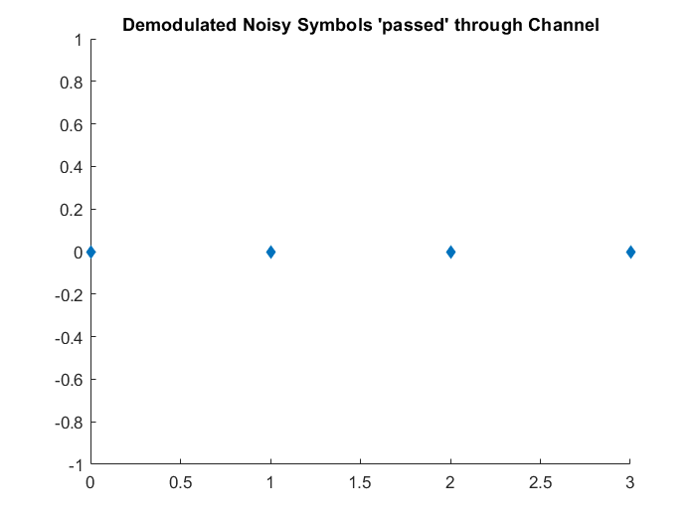
Noise and Demodulation

Slide 4
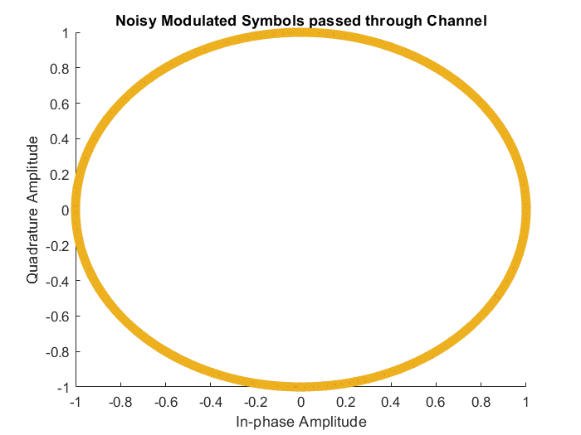
Random Walk Noise and Noise Sets
Created different sets of noise
Each set is an order of magnitude larger than the previous one
This noise only affects phase
The cumulative sum function was used to model the phase noise as a random walk process
Week 2

Slide 5
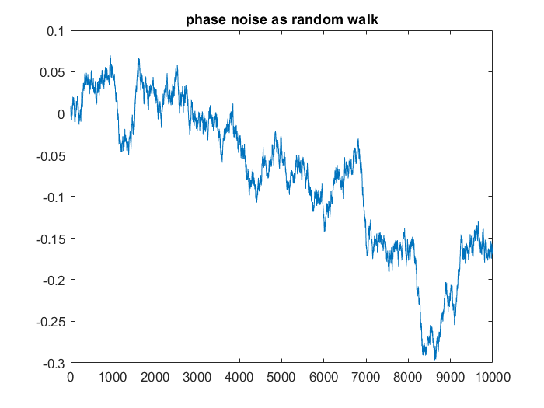
Random Walk Noise and Noise Sets

Slide 6
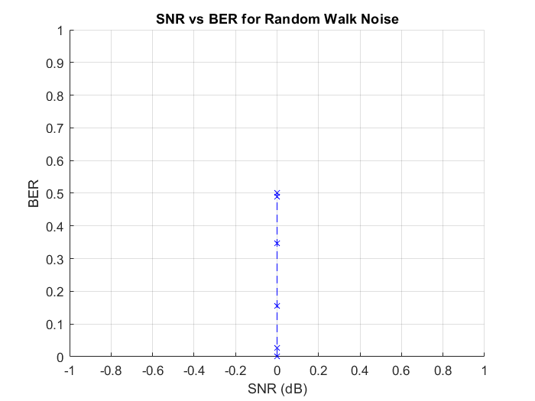
SNR and BER for Random Walk Noise
Plotting noise in a wrong way, bugs in code that need to be fixed
Attempting to measure noise with the snr Matlab function, cannot find the ratio between noisy signal and unfiltered signal correctly
Cannot find snr between symbols vector and their added phase noise vector either, approach replaced with specifying SNR directly instead of measuring it
Week 3

Slide 7
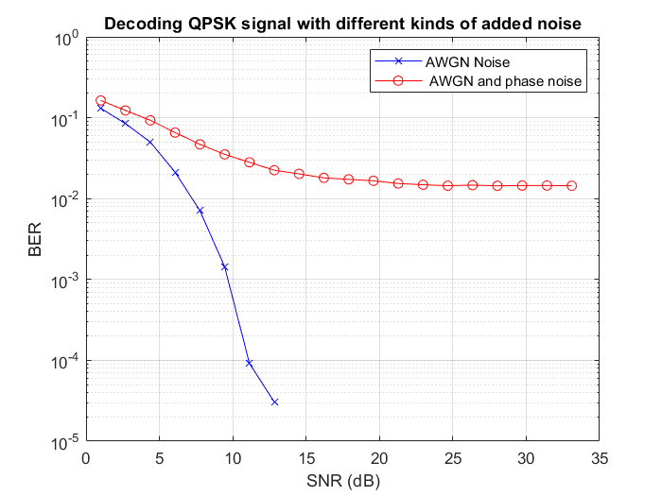
SNR and BER with AWGN
Repeating the transmission with AWGN noise gives the expected result.
Now two different noise models can be compared in further experiments
Created a known-symbol set instead of a random one for more control over the input

Slide 8
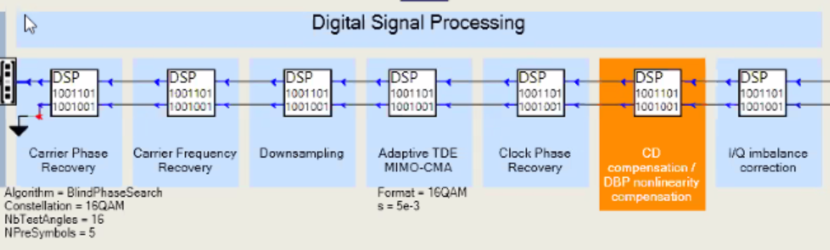
Working towards a transceiver model
Week 4

Slide 9
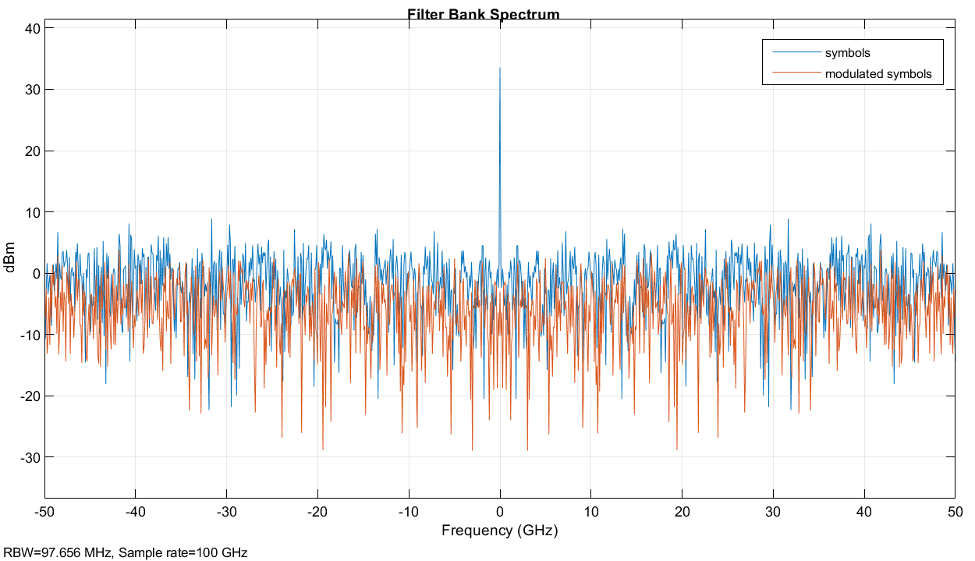
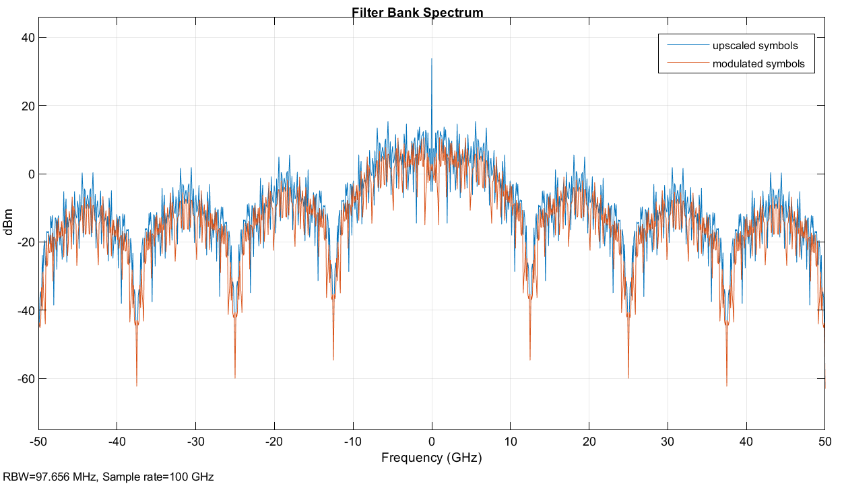
Upscaling and FFT
Upscaled the symbols by 8, plotted the spectrum before and after modulation
Compared the spectrum with the spectrum of the symbols without upscaling
Learning about the Filter Bank method for spectrum plotting
Week 5

Slide 10
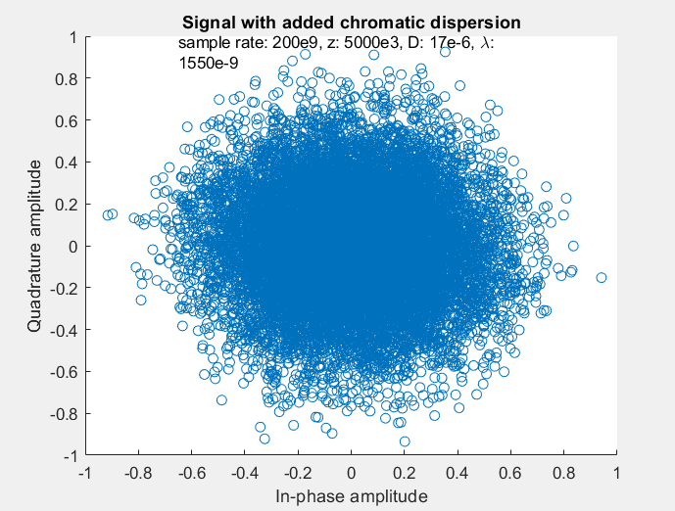
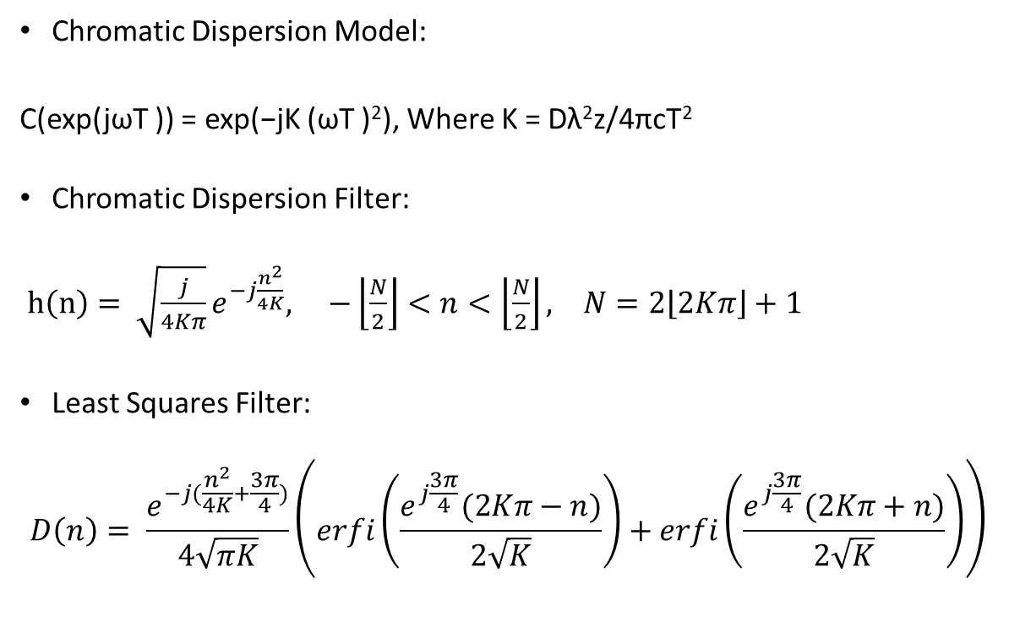
Chromatic Dispersion
Chromatic Dispersion Model:
C(exp(jωT )) = exp(−jK (ωT )²), Where K = Dλ²z/4πcT²
Chromatic Dispersion Filter:
$h\left(n\right)= \sqrt{\frac{j}{4Kπ}}e^{−j\frac{n^{2}}{4K}}, −\left\lfloor \frac{N}{2}\right\rfloor <n<\left\lfloor \frac{N}{2}\right\rfloor , N=2\left\lfloor 2Kπ\right\rfloor +1$
Least Squares Filter:
$$D\left(n\right)= \frac{e^{−j(\frac{n^{2}}{4K}+\frac{3π}{4})}}{4\sqrt{πK}}\left(erfi\left(\frac{e^{j\frac{3π}{4}}(2Kπ−n)}{2\sqrt{K}}\right)+erfi\left(\frac{e^{j\frac{3π}{4}}(2Kπ+n)}{2\sqrt{K}}\right)\right)$$
Unable to implement ω as a vector correctly, do not know how to get the taps for an impulse response for the CD Model
Weeks 6&7

Slide 11
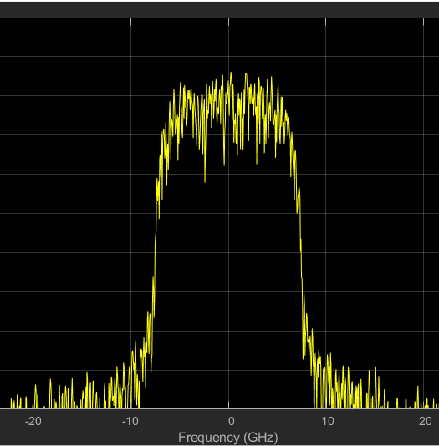
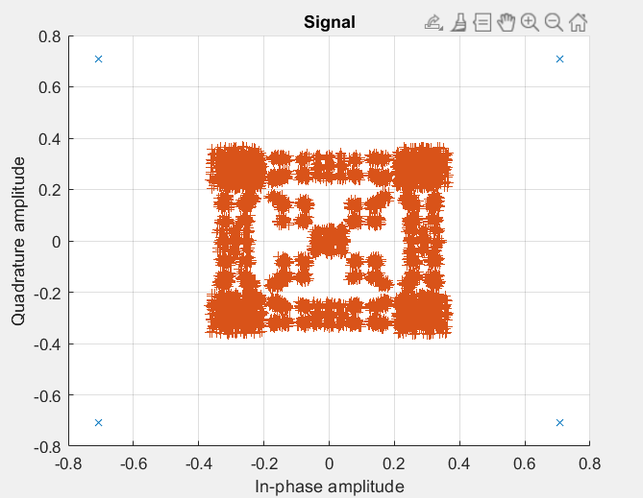
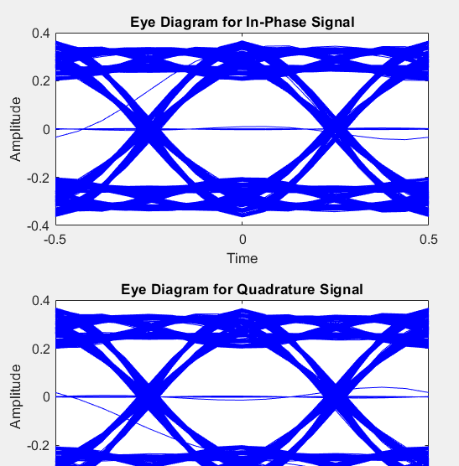
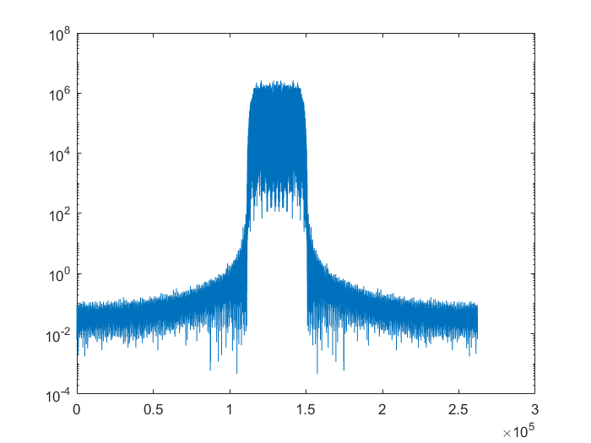
Pulse Shaping
Raised Cosine Filter with Interpolation/Decimation
Filter Parameters: Square Root, Roll off = 0.5, Taps: 32, Upsampling: 8
(looked at other filters: Nyquist)
Week 8

Slide 12
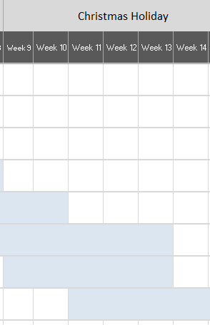
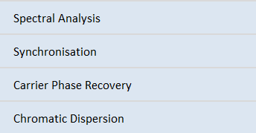
Need to Account for Delay in pulse-shaping filters
Delay is equal to N//2 where N is the number of taps used for a filter
> Using two filters (tx and rx) leads to a total delay of N taps
Therefore, need to shift output by N taps before demodulation
Gantt Chart
Winter Break

Slide 13
Approach to Solution of Desynchronisation: (Misalignment of Signals)
> First Implemented a direct shift by N which perfectly accounted for the delay. The problem with this approach is that other parts of the system also add delay and their delay is unknown. An approach that synchrosizes the TX and RX signal regardless of delay is needed.
> Realignment using cross-correlation has been implemented. The received downsampled signal after filtering with CD, AWGN and phase noise is correlated with the TX signal before pulse-shaping.
The Argmax of this cross-correlation is the delay between these 2 signals.
Problems:
This approach is not consistent and can also lead to values close to the true delay but off by 2-3 taps
Winter Break

Slide 14
Diagram of Current Process
Create an array of 32K random symbols
Modulate with QPSK, with initial phase π/4 and gray coding
Filter with a pulse shaping filter¹
Add AWGN
Add phase noise
Automatic gain control for normalization
Match filtering with a pulse shaping filter¹
Demodulate from QPSK
Estimate BER, SNR and plot spectra
¹Filter Parameters:
Upsampling/Downscaling = 8
Rolloff = 0.2
Tap Length = 32
Shape: Root Raised Cosine
Winter Break

Slide 15
Diagram of Expanded Process
Create an array of 32K random symbols
Modulate:
QPSK, 16QAM, 64QAM
QPSK: initial phase π/4 , gray coding
Filter with a pulse shaping filter¹
Add AWGN
Add phase noise
Automatic gain control for normalization
Match filtering with a pulse shaping filter¹
Demodulate from QPSK, 16QAM, 64QAM
Estimate BER, SNR and plot spectra
Add Chromatic Dispersion
Resolve Chromatic Dispersion
Frequency Equalisation
Carrier Equalisation
FEC Encoding/Preamble
Decode using FEC
¹Filter Parameters:
Upsampling/Downscaling = 8
Rolloff = 0.2
Tap Length = 32
Shape: Root Raised Cosine
Winter Break

Slide 16
Things to be integrated after individual testing
Filter Delay (Done)
16QAM (Done)
64QAM (Done)
Chromatic Dispersion implementation and DSP filters to account for it (CD done, filters not working still, inverse CD does work)
FEC (LDPC using dvb s2 standard)
Carrier Equalisation (After FE)
Frequency Equalisation (Requires Local Oscillator Implementation – Ask)
Winter Break

Slide 17
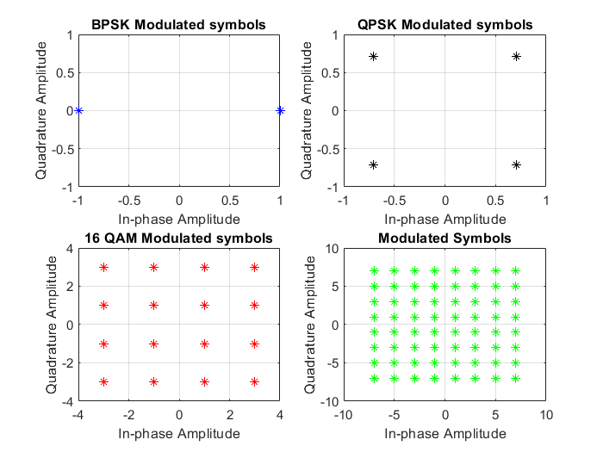
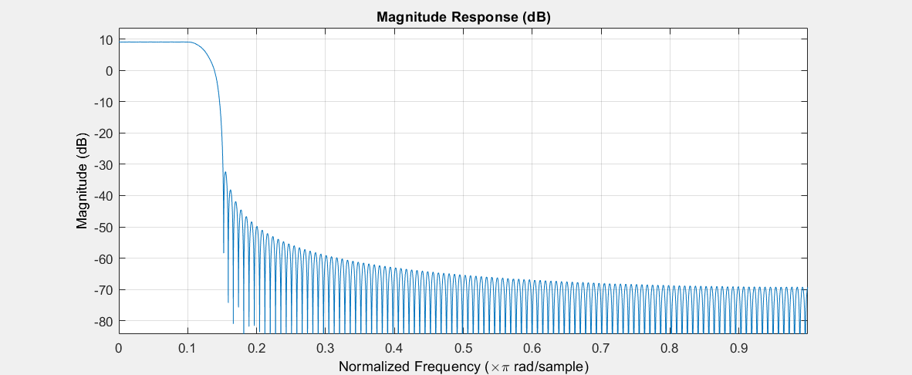
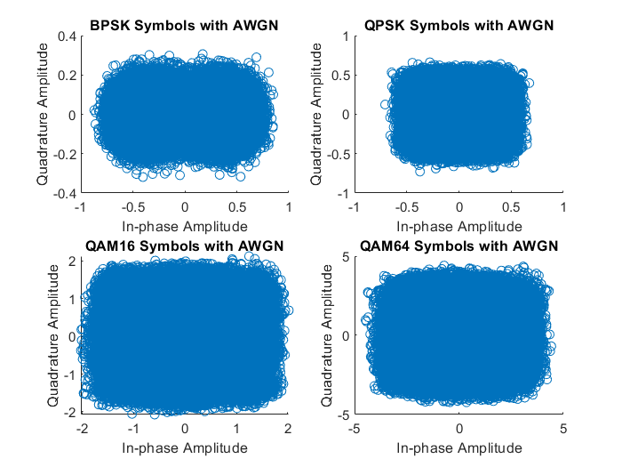
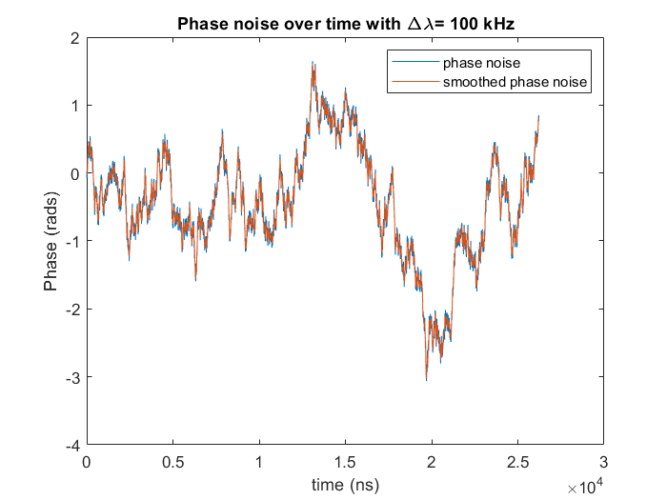
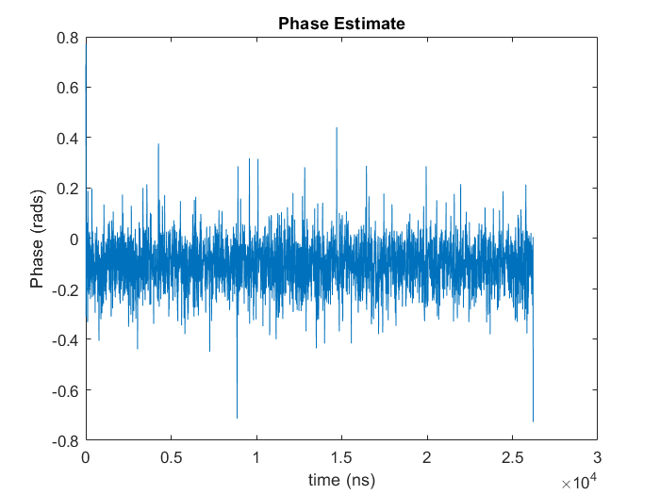
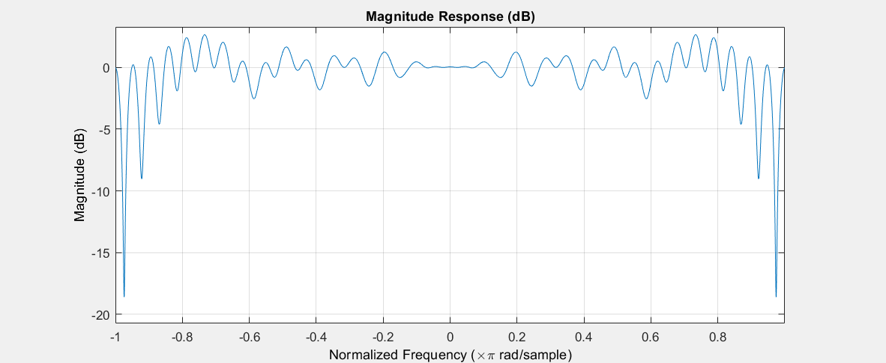
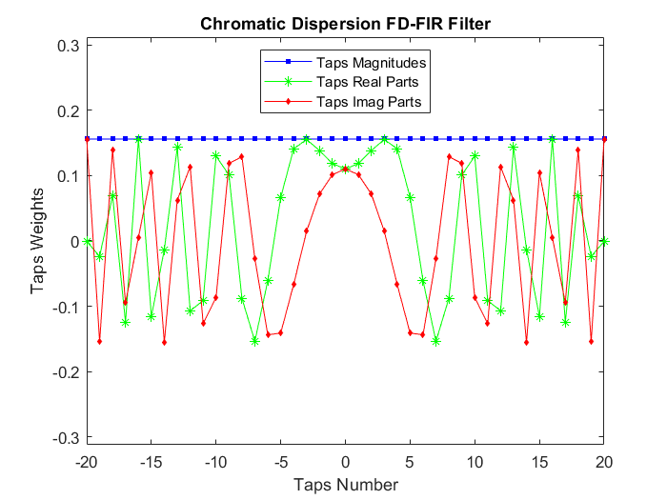
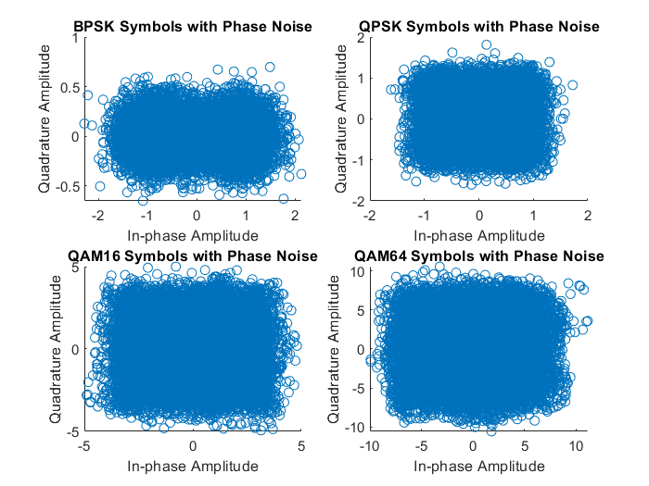
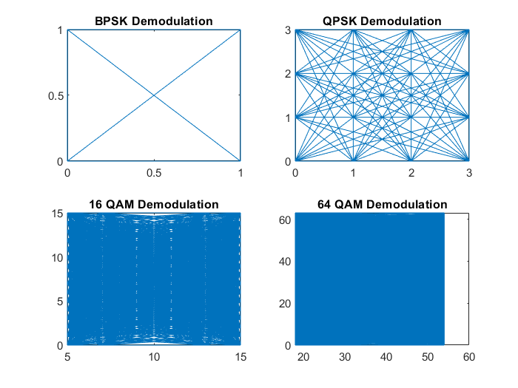
Winter Break

Slide 18
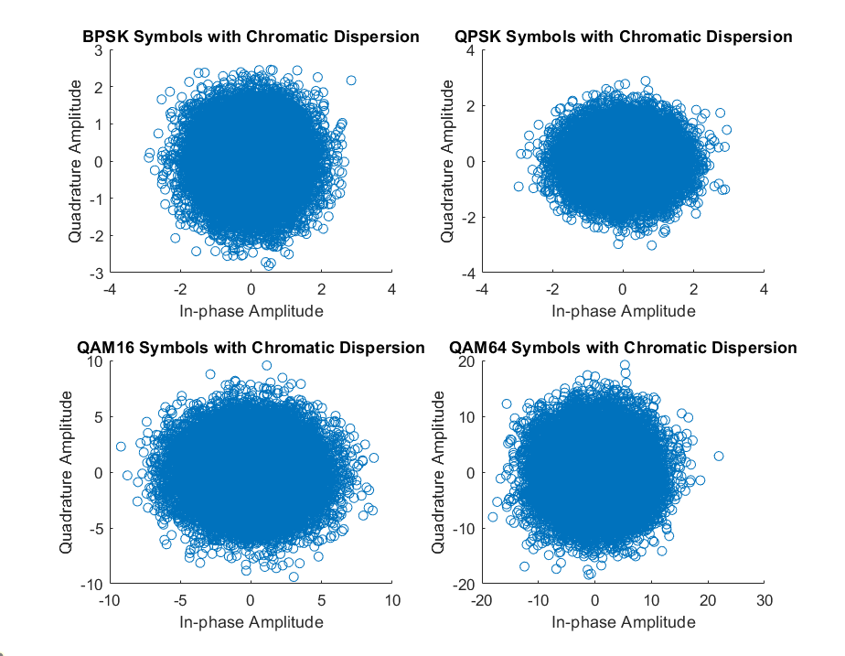
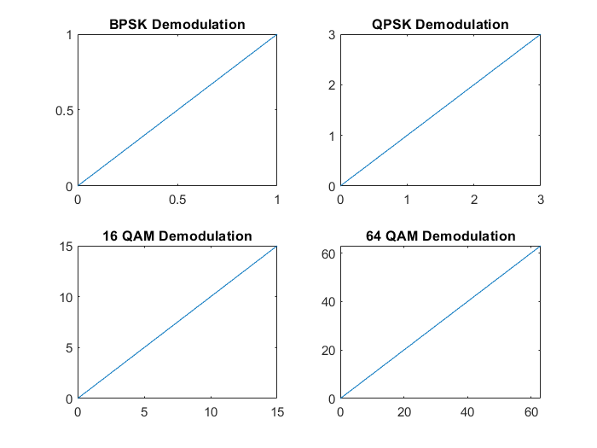
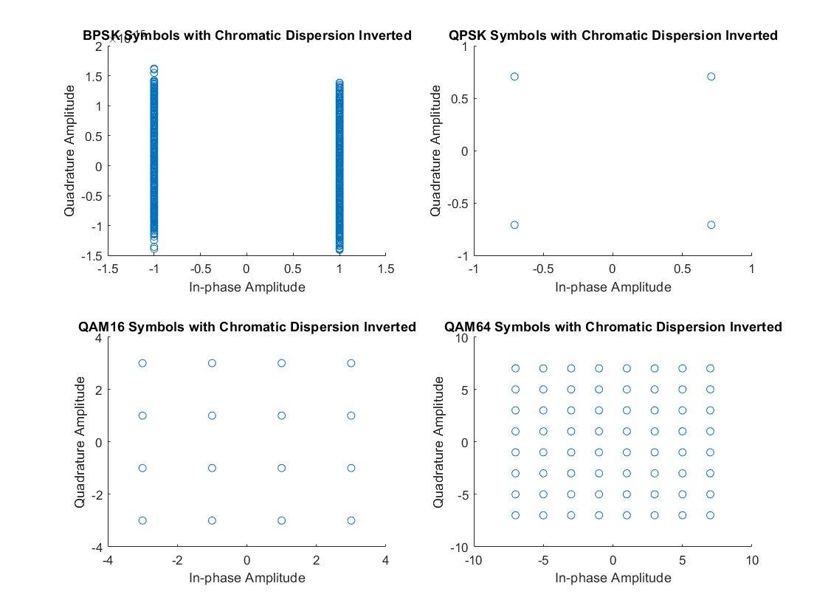
Chromatic Dispersion Fix
Implemented a version of the CD Model that inverses its operation
This allowed for debugging to effectively check if the original model was implemented correctly
Now applying the CD Model and then the Inverse CD Model perfectly demodulates the signal. This means that the Linear and OLS Filters should properly attempt to correct for CD. This is still not the case.
Considerations of moving into personally implemented adaptive filters instead of Matlab-provided ones
Week 1-2 Lent

Slide 19
Filter Taps Comparisons
Implementation from lectures in the time domain
Implementation from lectures in the frequency domain
Week 1-2 Lent

Slide 20
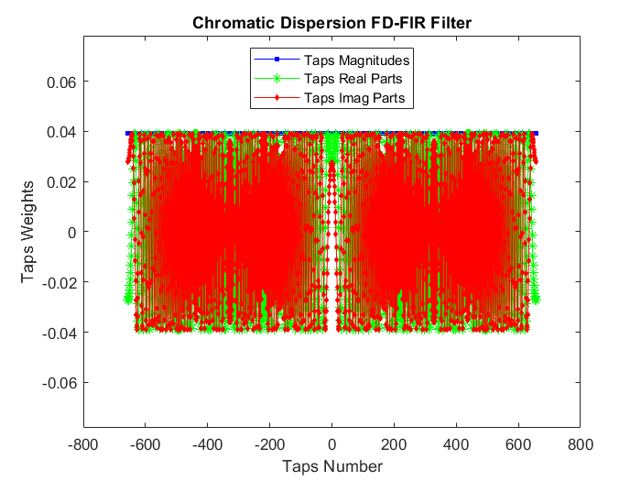
Filter Taps Comparisons
Modified Implementation from lectures in the time domain
(Real Parts now mirror Imaginary Parts)
Personal Implementation of FD-FIR Filter
Weeks 1-2 Lent

Slide 21
Carrier Equalisation
Adaptive Equalisation Methods
LMS, RMS filters. (MLSE as another option).
Resources lack implementation details, some pre-defined functions in MATLAB work for QPSK with AWGN, but could not be extended to equalise CD in QPSK or other modulation formats.
Alternative ways of Carrier Equalisation?
Need for Frequency Equalisation? (Requires implementation of non-linear effects, different polarisation for signals etc)
Weeks 1-2 Lent

Slide 22
Debugging Chromatic Dispersion: Results for Chromatic Dispersion and the Filter applied correcting it
4 different modulation formats BPSK, QPSK, 16QAM and 64QAM. The signals were pulse-shaped with a raised-cosine filter with an upsampling of 2 samples per symbol.
A Chromatic Dispersion Model was applied to these samples. Scatter plots were made for each modulation between distances of 10 and 110 km.
A chromatic dispersion filter was applied immediately after CD was introduced and scatter plots were made for comparison.
Weeks 3-4

Slide 23
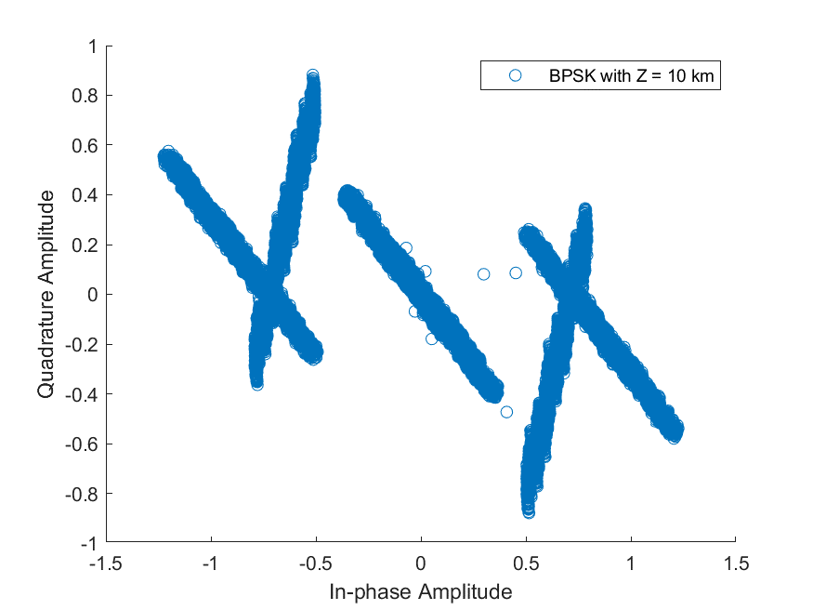
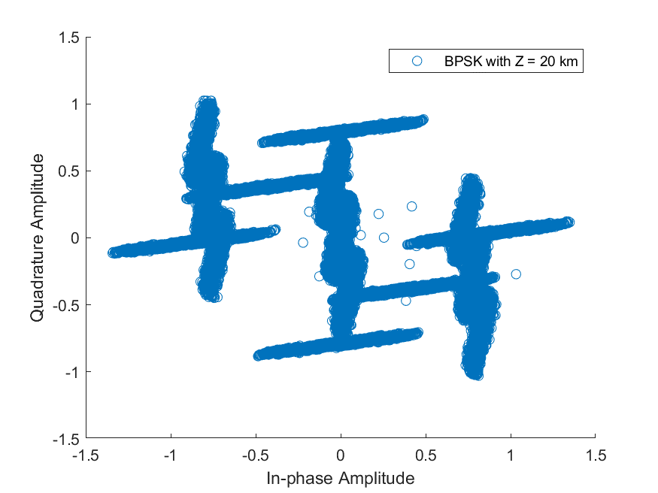
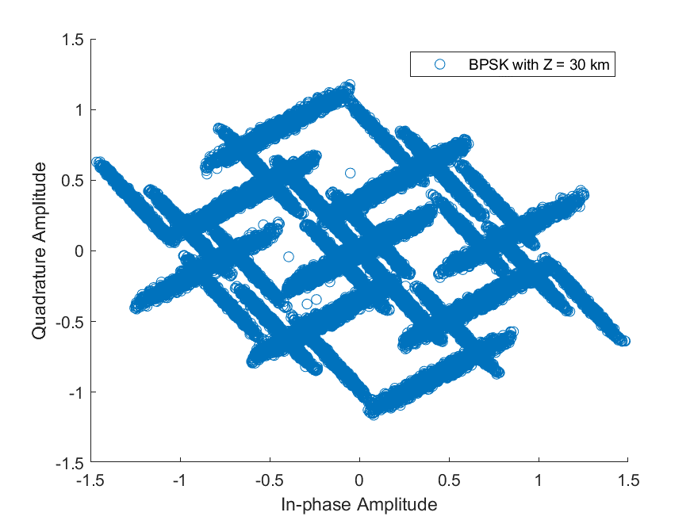
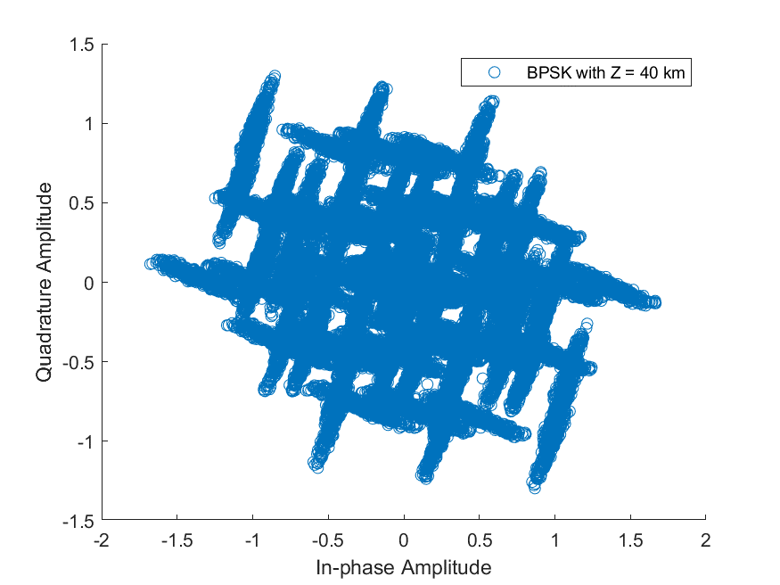
BPSK Chromatic Dispersion
Weeks 3-4

Slide 24
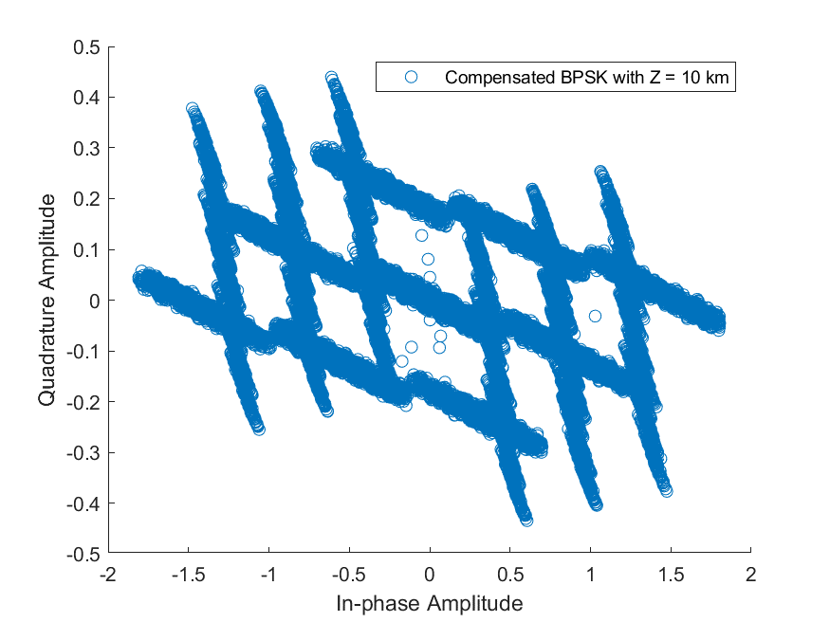
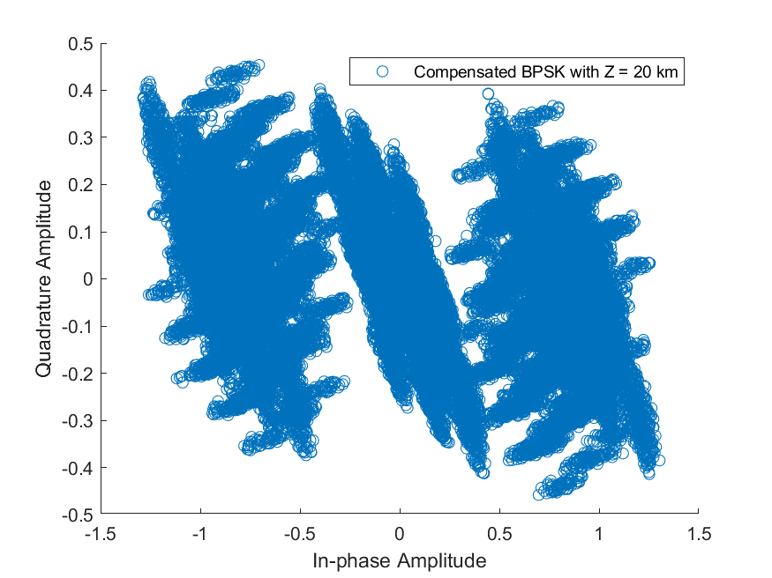
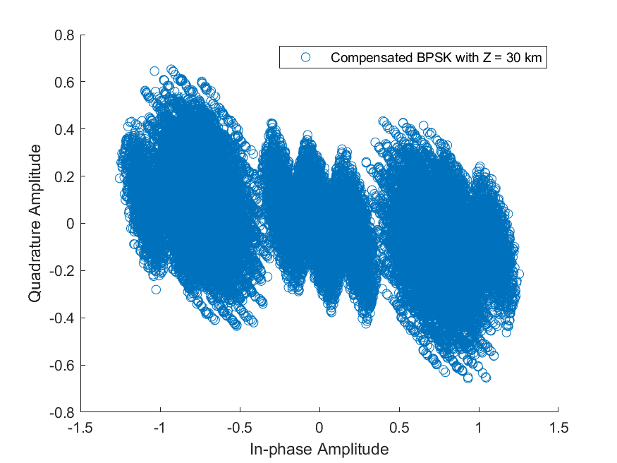
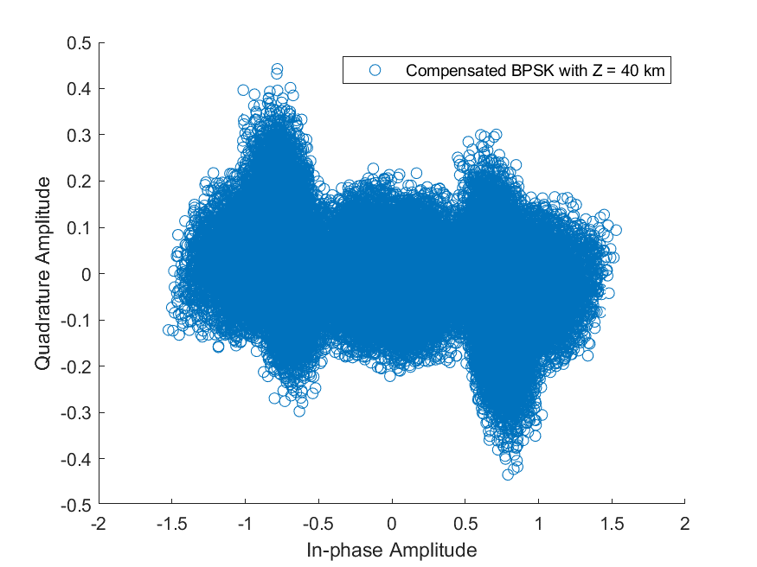
BPSK Compensation Filter
Weeks 3-4

Slide 25
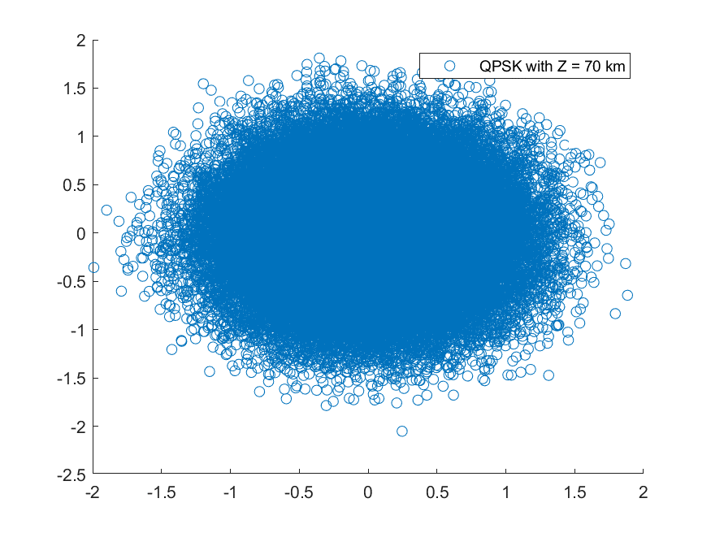
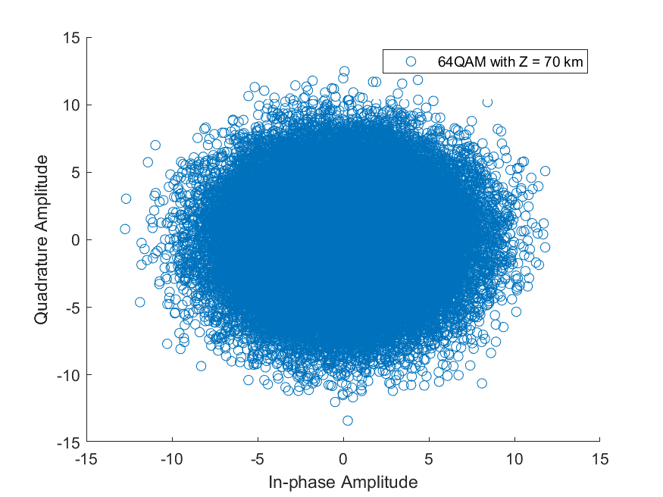
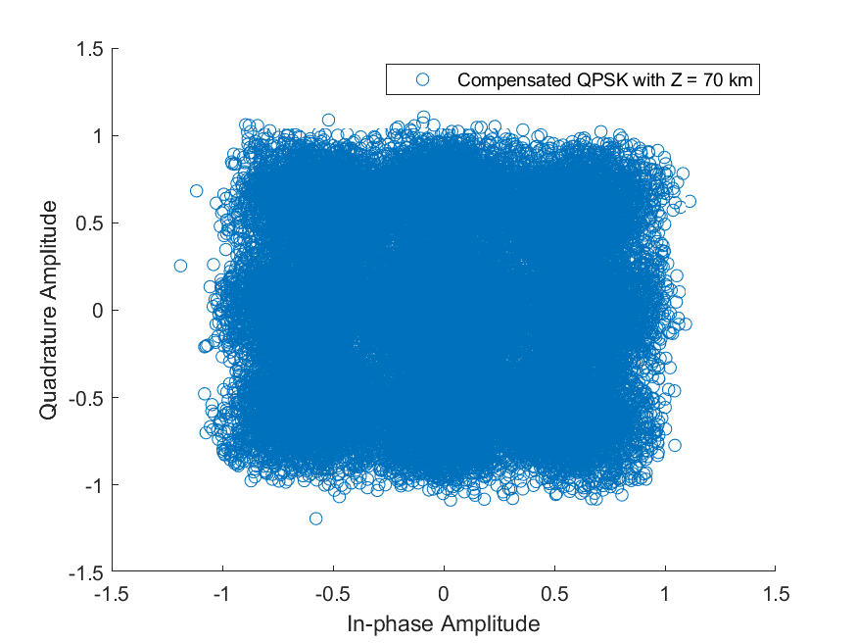
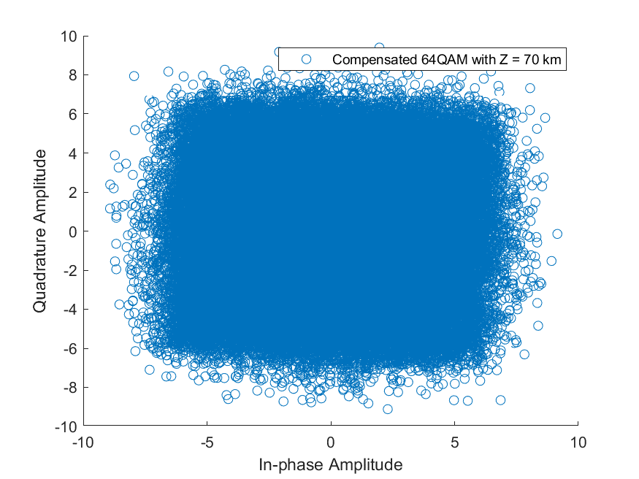
Notes on CD
Samples of applied CD
All other modulation schemes (QPSK, 16,64QAM) show a pattern similar to AWGN noise with only discernible difference being greater deviations in amplitudes of symbols as distance increased.
The CD filter effects BPSK symbols at small distances but otherwise does not practically reverse the effects of CD at any distance for higher modulation formats
Compensation of CD
Weeks 3-4

Slide 26
Notes on effects of BPSK
Both the CD model and the filter create a third ‘symbol’ around 0
Above 10km the CD filter does not account for amplitude deviations anymore but manages to split symbols into three regions around points -1, 0, and 1
With high SNRs, it is still decodable
Weeks 3-4

Slide 27
Parameters Used:
Symbols: 32768
Upsampling: 2
Samples: 65536
Sample Rate: 64e9
T = sample rate^-1
Distances z: Between 10km to 110km in steps of 10km
lambda = 1550e-9
D = 16e-6 (s/m/m) == 16 ps/nm/km
If z is too small, M as defined in Lecture 5 becomes 0 due to the floor function. Therefore, I set the filter to 1 tap if that is the case.
Weeks 3-4

Slide 28
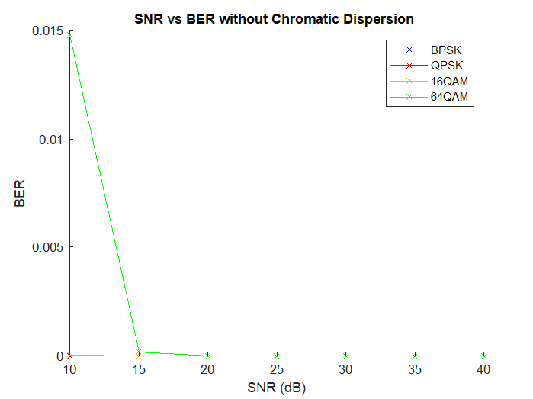
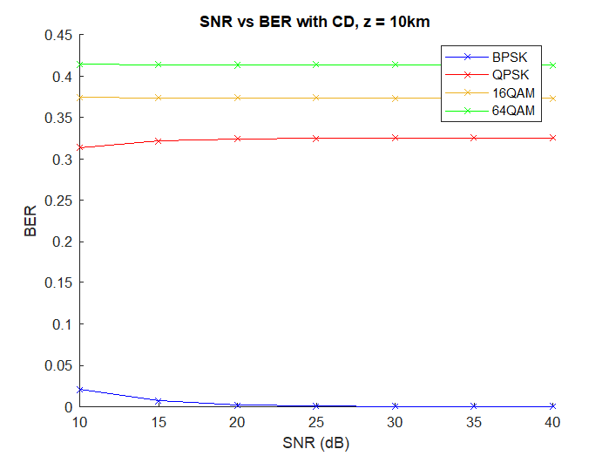
SNR vs BER graphs after applying CD and then filtering it with the compensating filter
Weeks 3-4

Slide 29
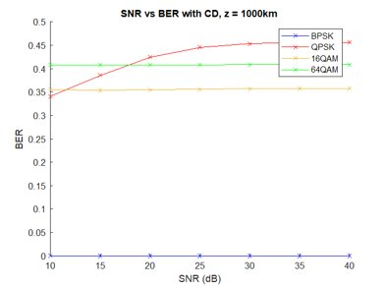
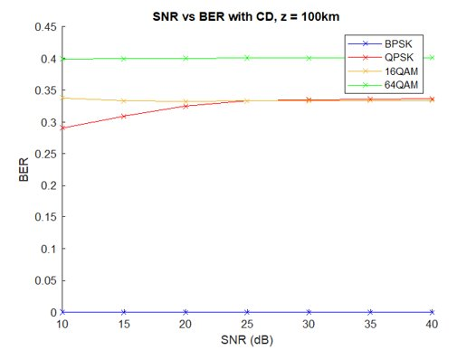
SNR vs BER graphs after applying CD and then filtering it with the compensating filter
Weeks 3-4

Slide 30
Reconfiguration of Model
Electrical Domain - Transmitter
Pseudorandom Data Symbols
Forward Error Correction Encoding
Modulation
Optical Domain - Channel
Add Phase Noise
Add AWGN
Add Chromatic Dispersion
Pulse Shape Filtering – Upsampling
Electrical Domain - Receiver
Matched Filtering
Downconverting to 2 samples per symbols
Chromatic Dispersion Compensation
Carrier Down-sampling Selection
Carrier Equalisation
Estimate BER, SNR and plot spectra
Decoding of FEC/PS
Demodulation
Alignment of Signals
Week 5

Slide 31
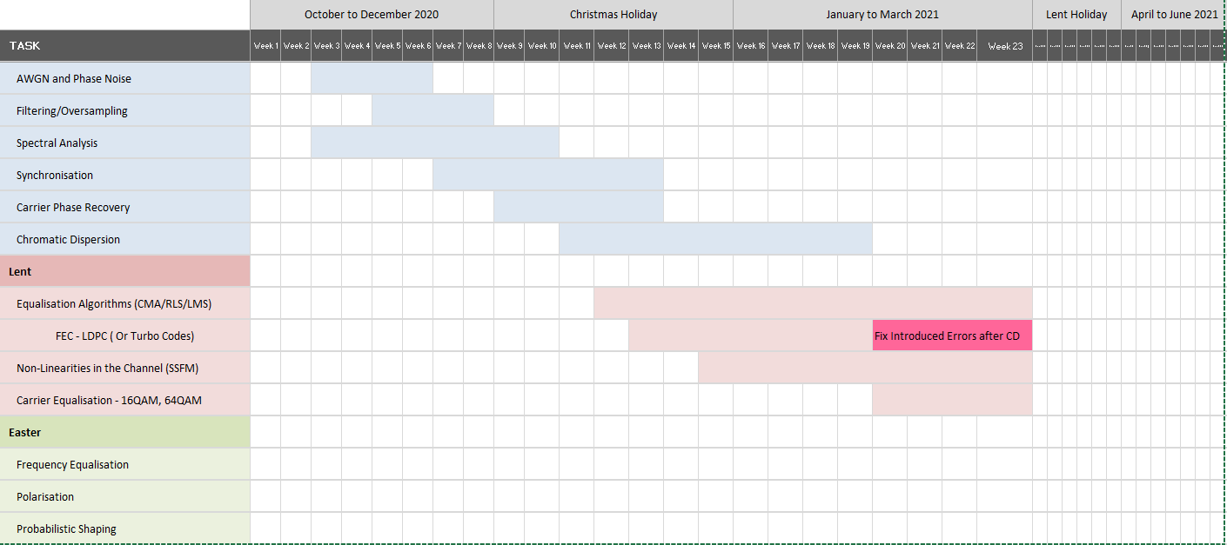
Updated Gantt Chart

Slide 32
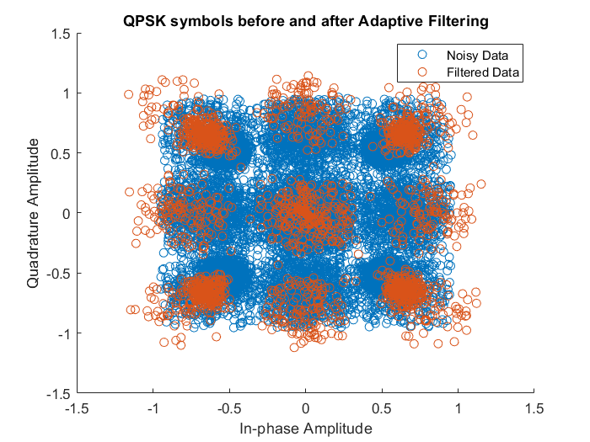
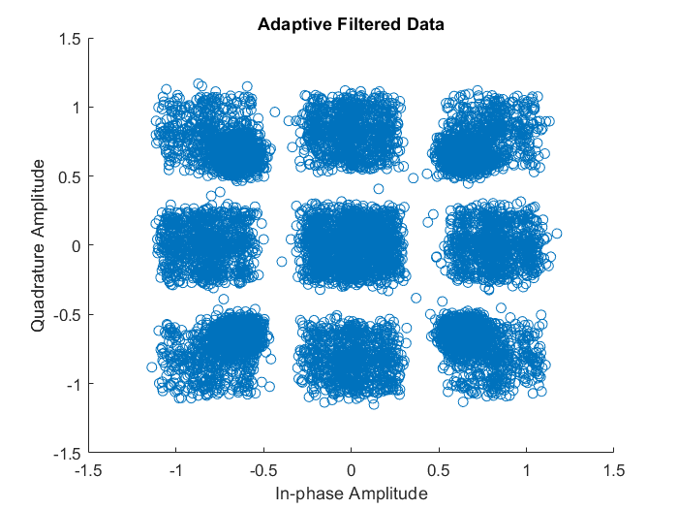

Adaptive Equalisation (No Noise)
Parameters:
symbol_rate = 32e9;
upsampling_factor = 2;
CMA Algorithm:
num_symbols = 8192;
h_taps = 17;
h(9) = 1;
training_size = 2000;
mu = 0.002;
Demodulation:
errors = 0
BER = 0
Week 5

Slide 33



Adaptive Equalisation
Parameters:
AGWN SNR = 20;
symbol_rate = 100e9;
upsampling_factor = 2;
z = 50e3; % m
D = 17*10^-6; % s/m/m
lambda = 1550*10^-9; % m
Demodulation:
errors = 2
BER = 3.0604e-5
CMA Algorithm:
num_symbols = 32K;
h_taps = 17;
h(9) = 1;
training_size = 1639;
mu = 0.002;
Week 6

Slide 34


Error Curve Considerations
Log(Magnitude)
Log(Magnitude)
Sample Index
Sample Index
Personal Function Output
Expected Trend of Error Magnitude
Week 6

Slide 35


CMA Implementation
Attempts at fixing this:
Tried different implementations of the CMA algorithm
Tried to estimate and correct the phase after filtering in chuncks instead of using the entire signal
(Although it was understandably unrealistic, I reversed the order of downsampling and adaptive filtering to test the CMA Algorithmn on only symbols)
Without Adaptive Equalisation
With CMA Equalisation
BER = 0, Errors = 0
BER = 6.3e-4, Errors = 41
32K Symbols Transmitted, symbol rate = 50e9 GHz
Same amount of Chromatic Dispersion (Distance=40e3, D=17ps/nm/km)
Only static equalisation and downsampli sample decision made by the squared mean of all symbols
Static and Adaptive Equalisation, adaptive equaliser updates every second sample
and therefore downsamples to 1 sample per symbol
(Plot Different halves of diagrams for checking)

